Slide 1

GOLDEN FUTURE AUNG MYIN THU CO.,LTD
Overseas Employment Agency
Company Profile

Slide 2
OUR COMPANY
As one of Myanmar’s leading recruitment agencies, we specialize in being the link between job seekers and employers, helps to facilitate the matching and communication of job opportunities between job seekers and employers to provide a perfect integration to the company.
Our license was awarded by MYANMAR OVERSEAS EMPLOYMENT AGENCIES FEDERATION (MOEAF) license number: 166/2019
Our team derives deep satisfaction in helping employers find talent to drive their businesses forward while placing candidates into fulfilling jobs and careers.
We adopt fair-employment practices, recruit talents on the basis of merit (such as skills, experience or ability to perform the job), regardless of age, race, gender, religion, marital status and family responsibilities, or disability.

Slide 3


VISION & MISSION
Our approach to business is firmly underpinned by our core values, championing freedom, discipline and fairness in delivering exceptional standards of service to our clients with speed and sincerity.
Our Vision
We are committed to link great companies with great employees by providing the highest quality of human resource and employment services.
Templates PowerPoint Presentation
Our Mission

Slide 4
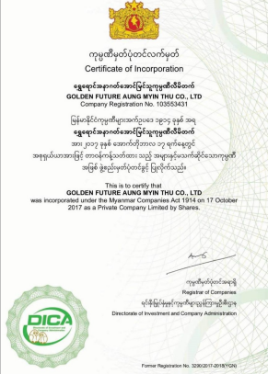
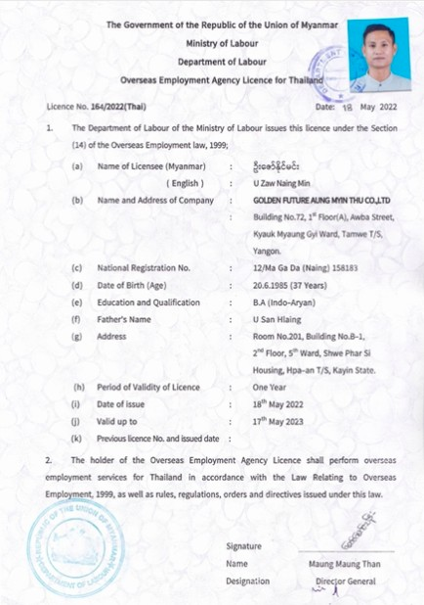
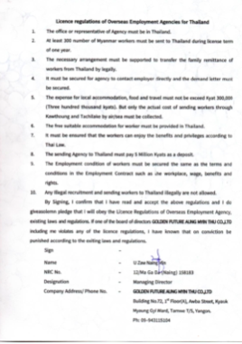
OUR COMPANY

Slide 5
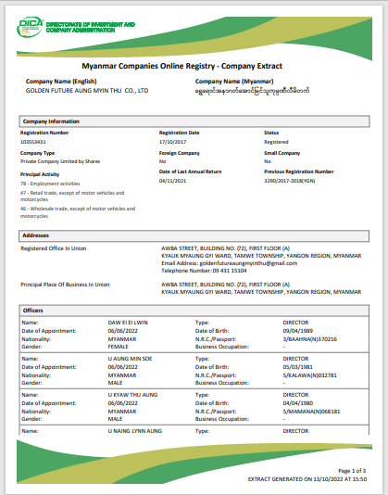
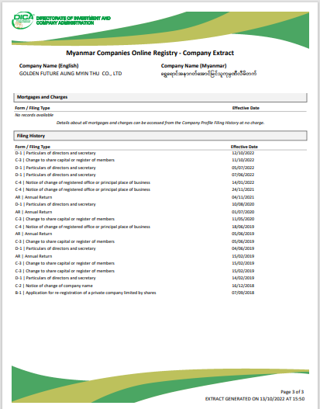
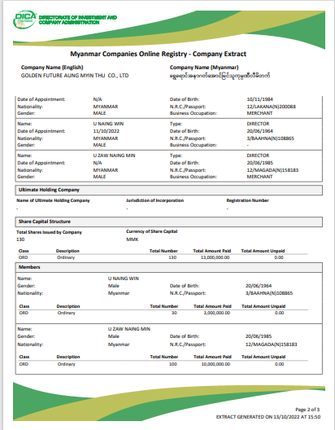
OUR COMPANY

Slide 6
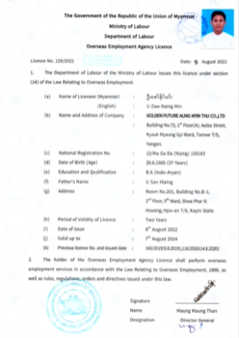
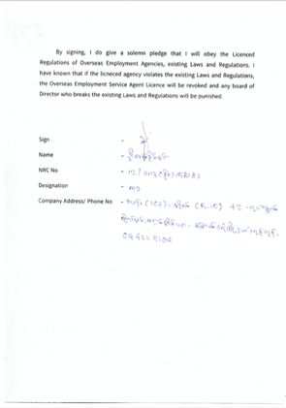
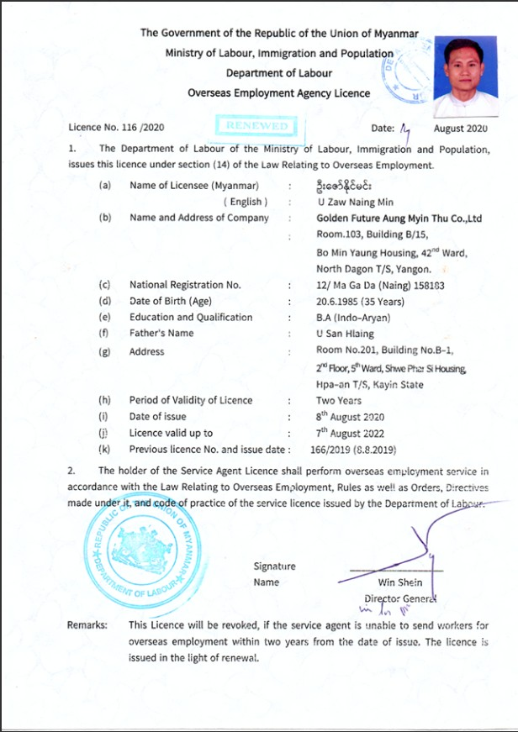
OUR COMPANY

Slide 7
OUR ORGANIZATION CHART
CEO
Managing Director
Director
Director
Director
Director
General
Manager
Office Staff
Office Staff
Office Staff

Slide 8
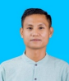
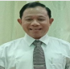
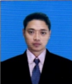
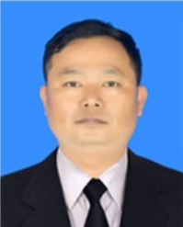
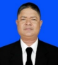
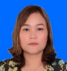
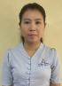
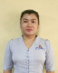
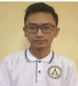
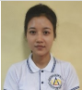
OUR ORGANIZATION CHART
Mr. Zaw Naing Min
Managing Director
Mr. Naing Win
Director
Mr. Naing Lynn Aung
Director
Mr. Aung Min Soe
Director
Mr. Kyaw Thu Aung
Director
Ms. Ei Ei Lwin
Director
Ms. Aye Sandar Win
General Manager
Ms. Wai Wai Hnin
Office Staff
Mr. Nyan Htet Linn
Office Staff
Ms. May Zuly
Office Staff

Slide 9
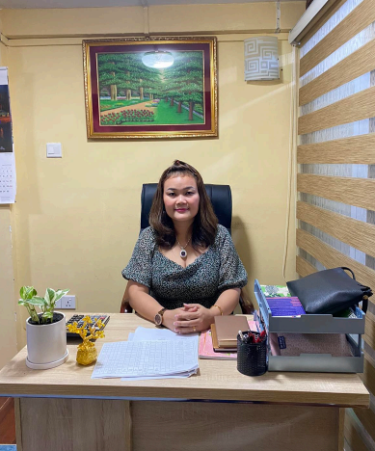
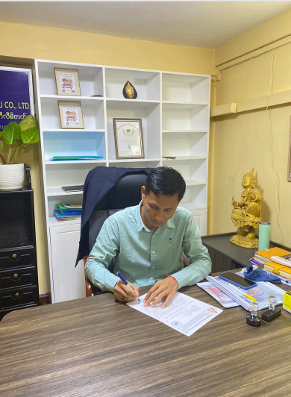
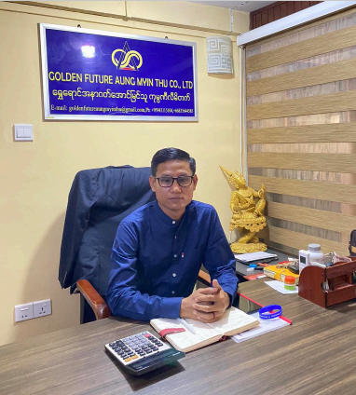
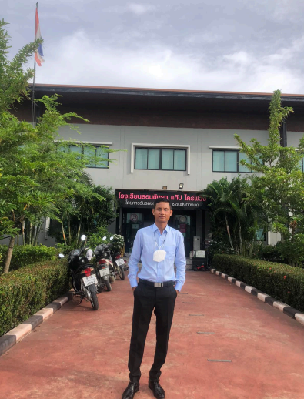
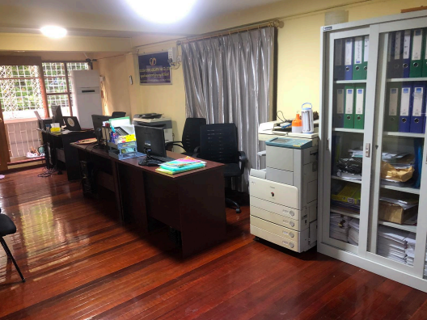
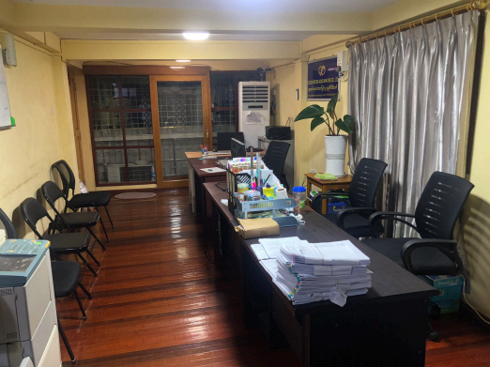
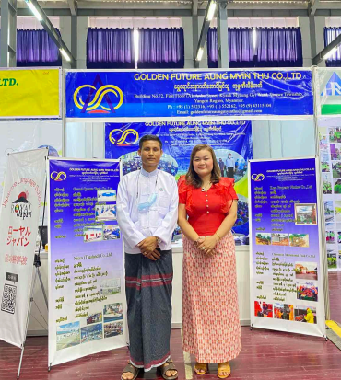
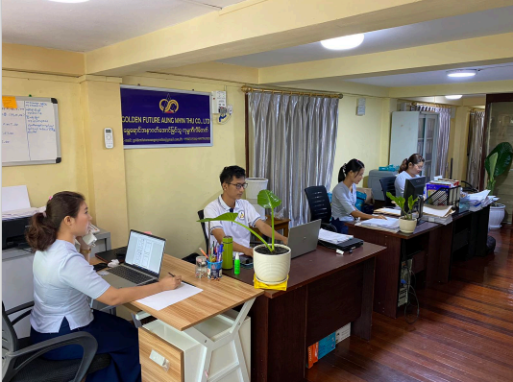
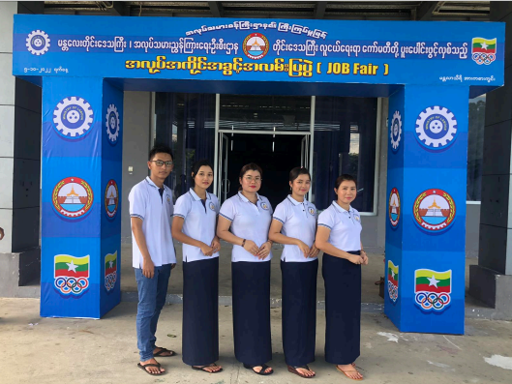
OUR TEAM

Slide 10
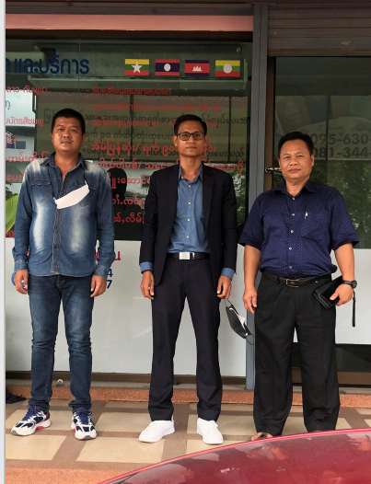
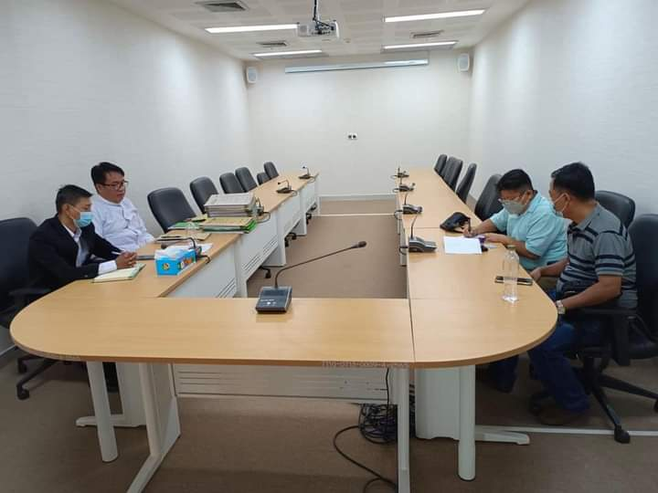
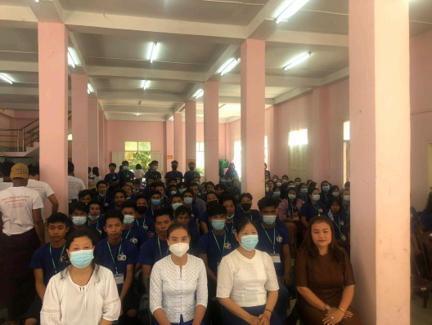
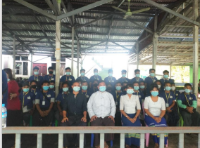
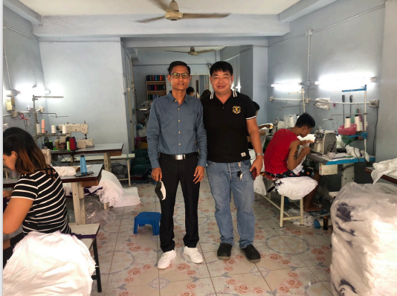
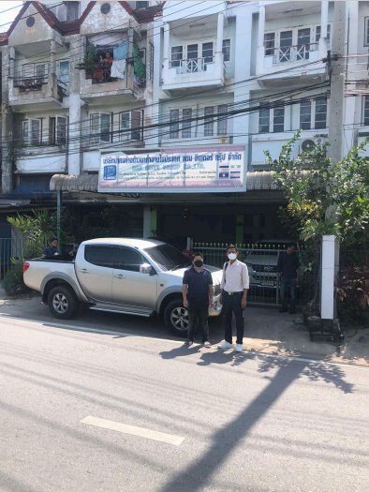
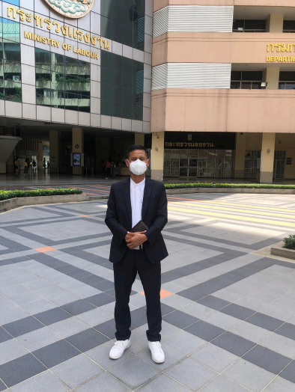
OUR SERVICES

Slide 11
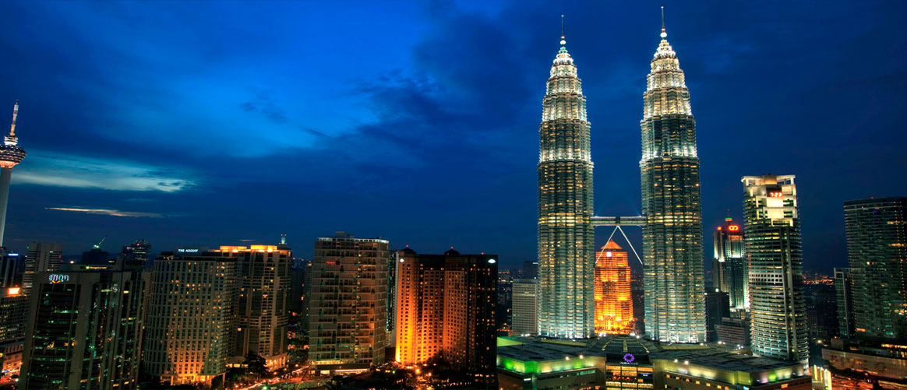
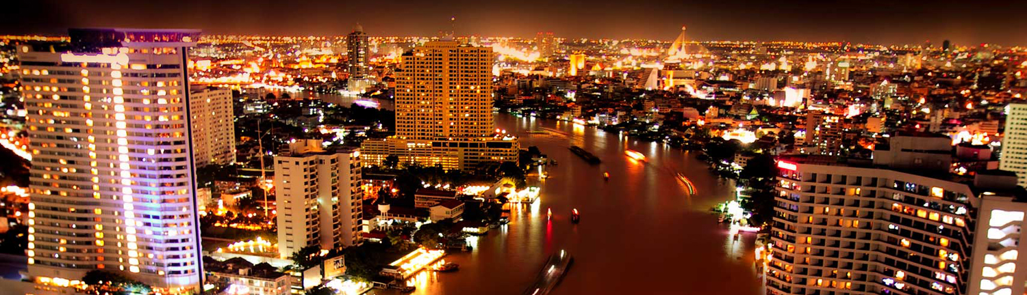




OUR SERVICES
Thailand
Singapore
Malaysia
Japan

Slide 12
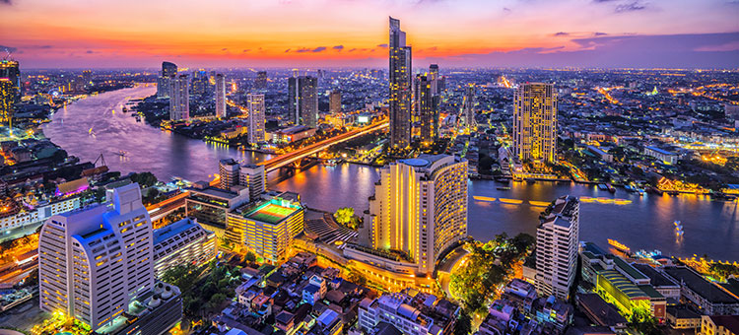
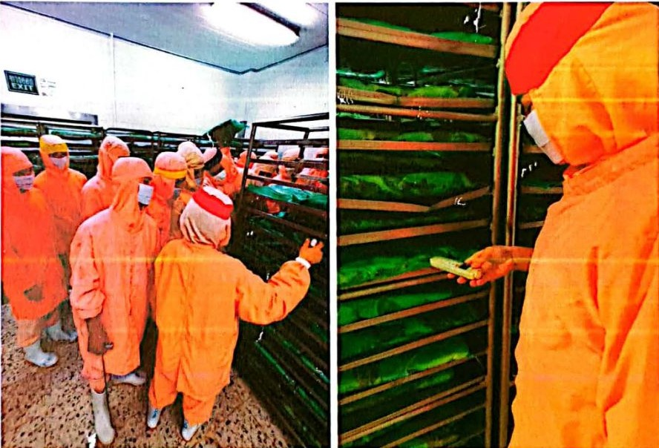
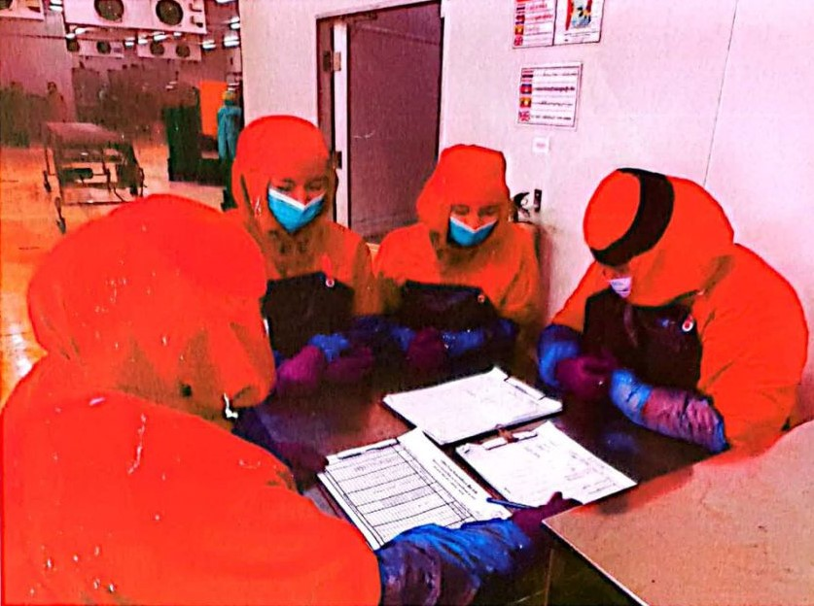
Thailand
Food Production

Slide 13
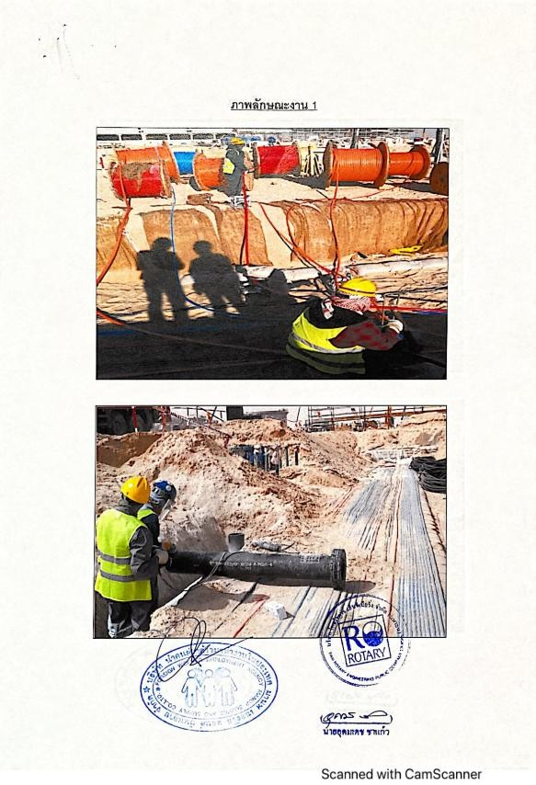
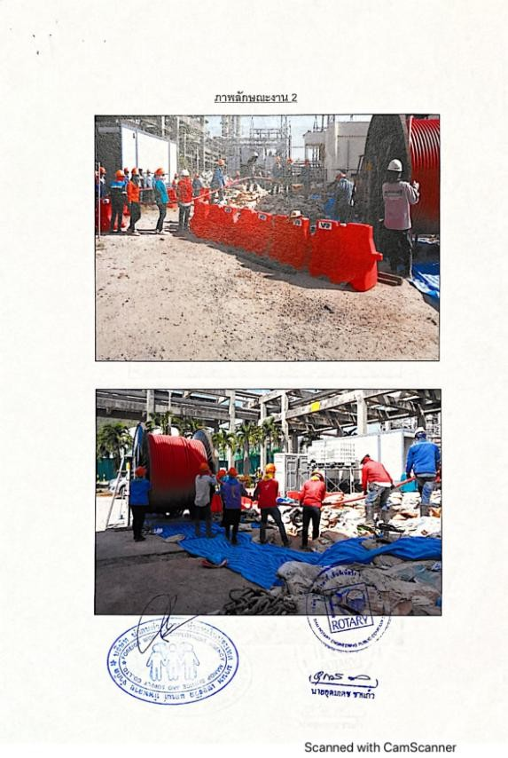
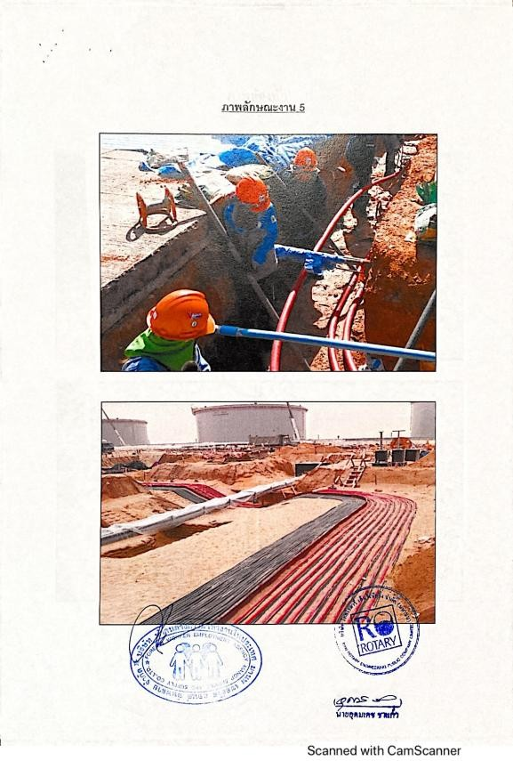
OUR SERVICES
Cable Installation Work

Slide 14
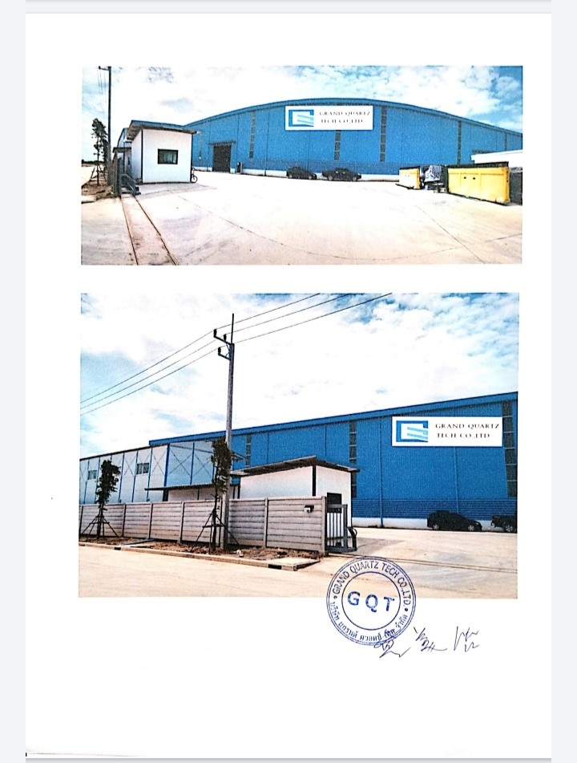
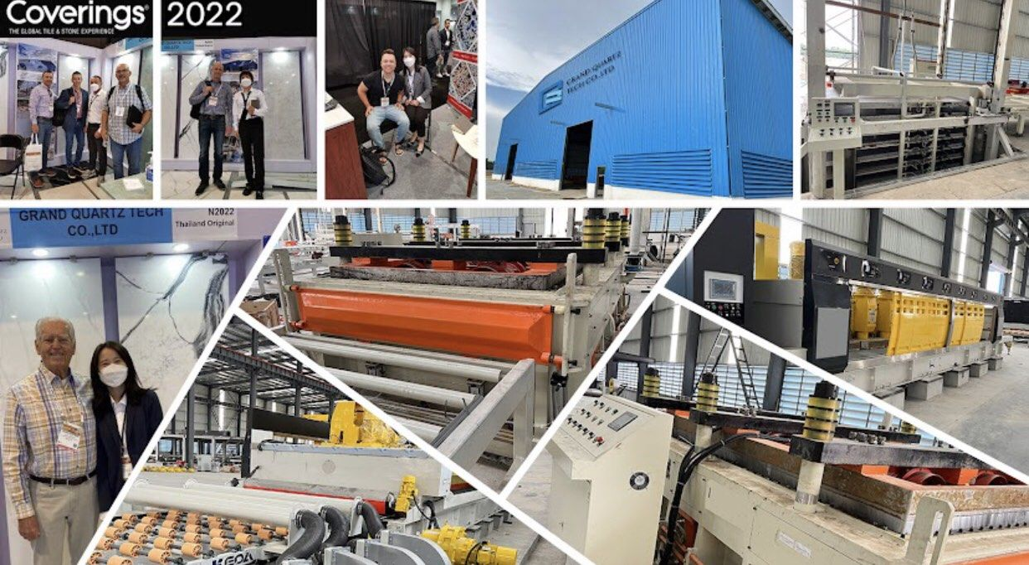
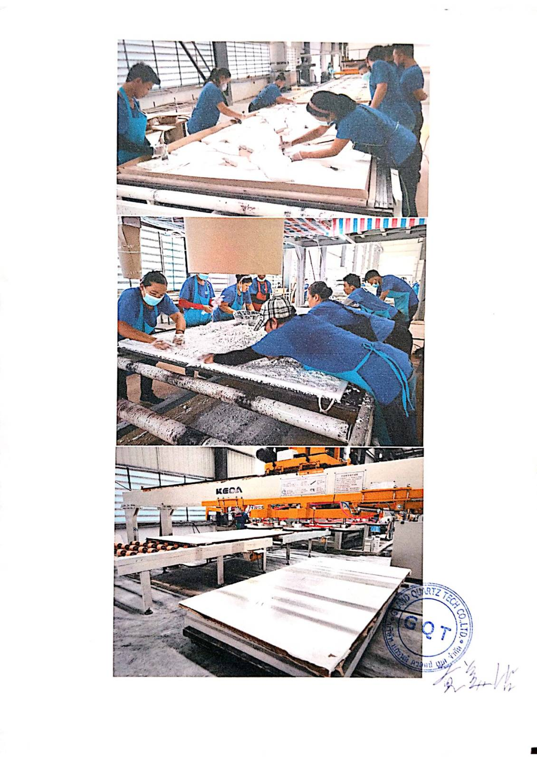
OUR SERVICES
Slab Manufacturing Industry

Slide 15
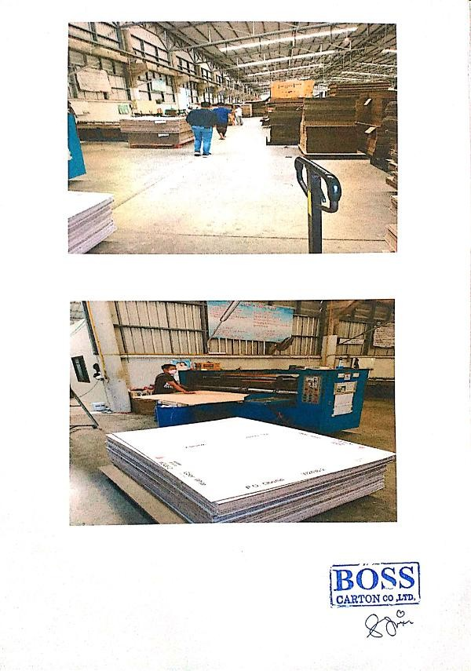
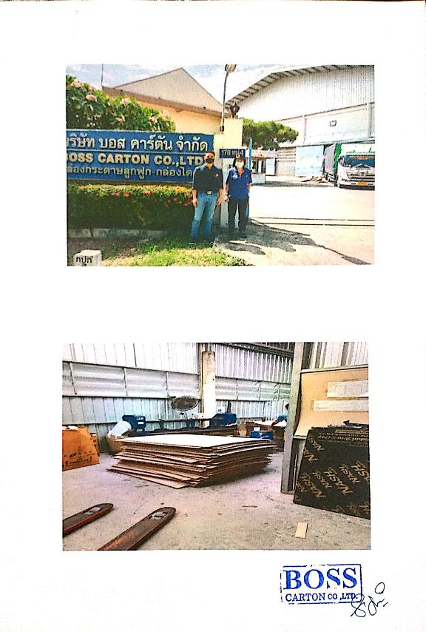
OUR SERVICES
Paper Manufacturing Industry

Slide 16
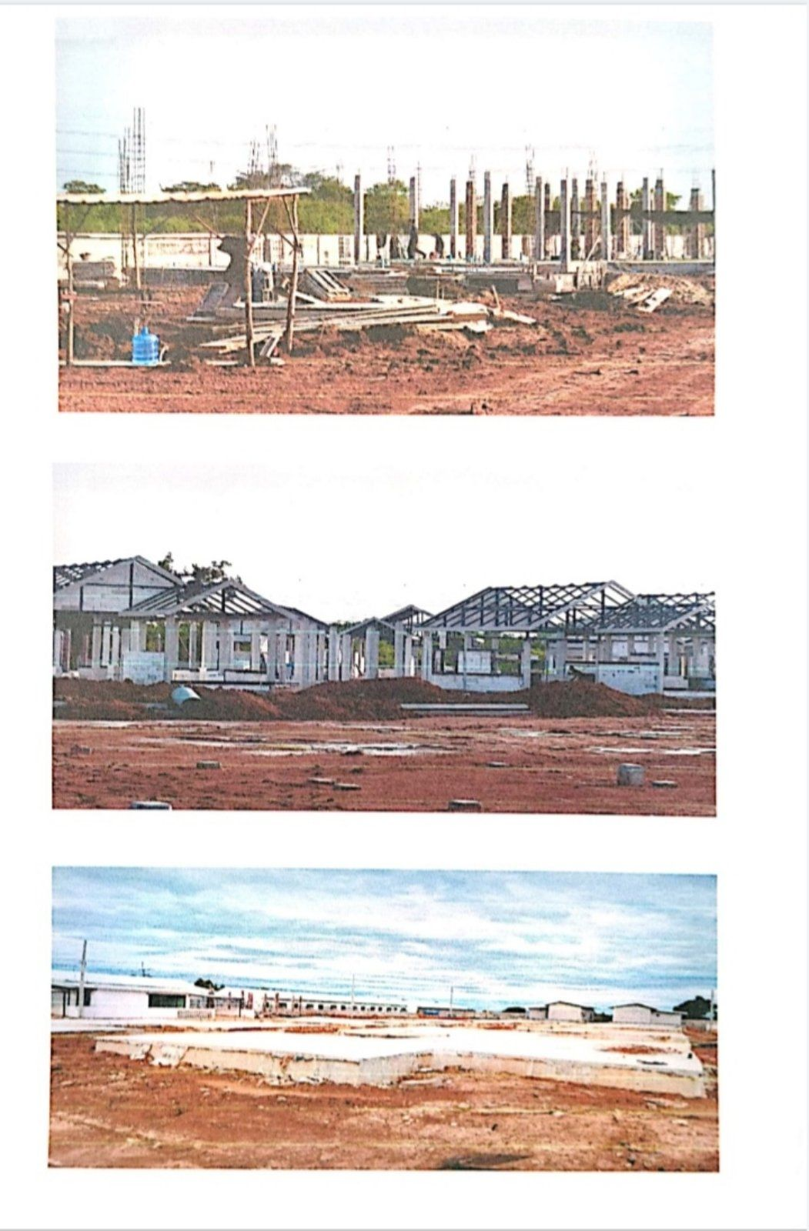
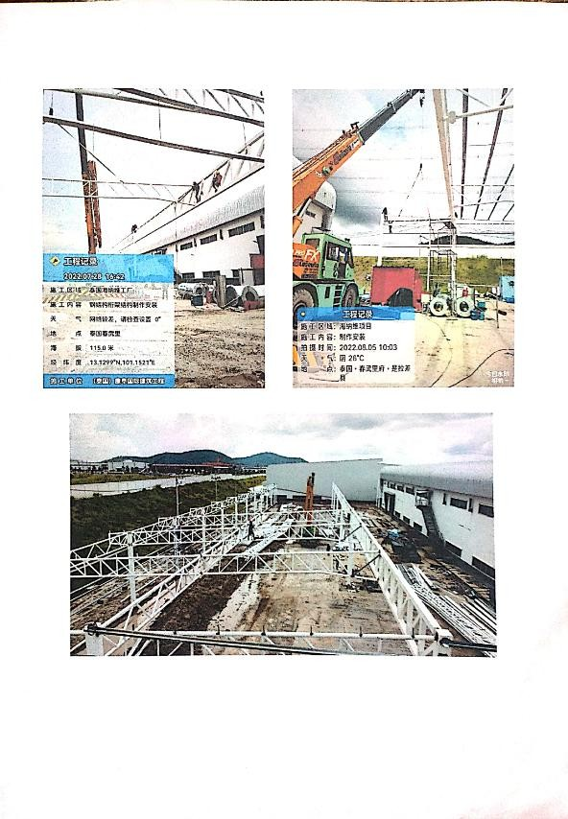

OUR SERVICES
Construction

Slide 17



OUR SERVICES
Garment Industry

Slide 18

OUR SERVICES
Sports Equipment Manufacturing

Slide 19




OUR SERVICES
Coconut Production Industry
OUR ACTIVITIES

Slide 20





OUR ACTIVITIES

Slide 21




OUR ACTIVITIES

Slide 22





OUR ACTIVITIES

Slide 23




OUR ACTIVITIES

Slide 24




GOLDEN FUTURE AUNG MYIN THU CO.,LTD
Overseas Employment Agency
CONTACT US
01-9552316, 01-9552162, +959-43115104, +66805453522
goldenfutureaungmyinthu@gmail.com
Building No.72,1st Floor(A), Awba Street, Kyauk Myaung Gyi Ward, TarmweTsp, Yangon, Myanmar.
www.goldenfutureaungmyinthu.com

Slide 25
GOLDEN FUTURE AUNG MYIN THU CO.,LTD
Overseas Employment Agency
Thank you

